Slide 1
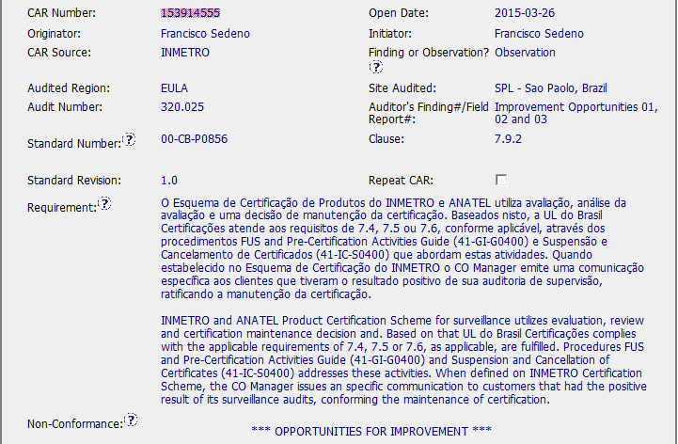
CAR 153914555
Spanish
Requirements are for Non-UL Marks. Comments are Opp for Improvements (not Finding / Ob)

Slide 2
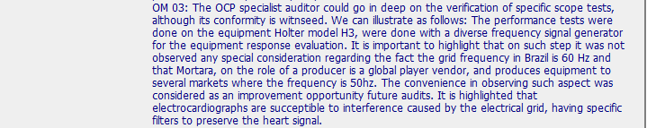
CAR 153914555
Non-conformance talks about documents not matched. & local auditor should go deeper (need to put more details on the audit report, maybe)

Slide 3
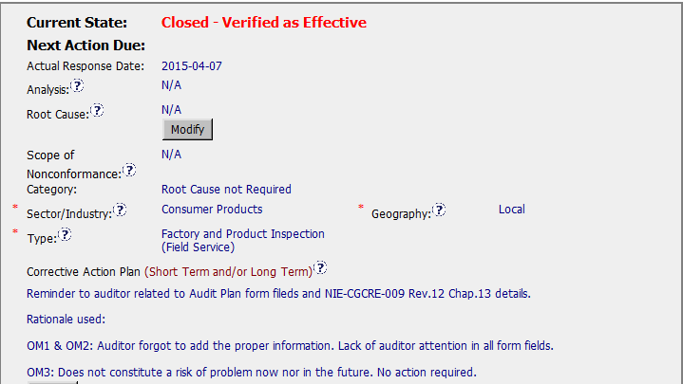
CAR 153914555
Correct Category for Observation
Ob / OFI should not have any root cause analysis. However, since most of accreditors require have one, they are here. (OFI doesn’t need RCA normally.)

Slide 4
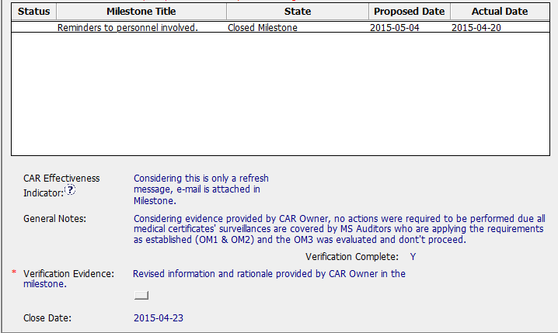
CAR 153914555

Slide 5
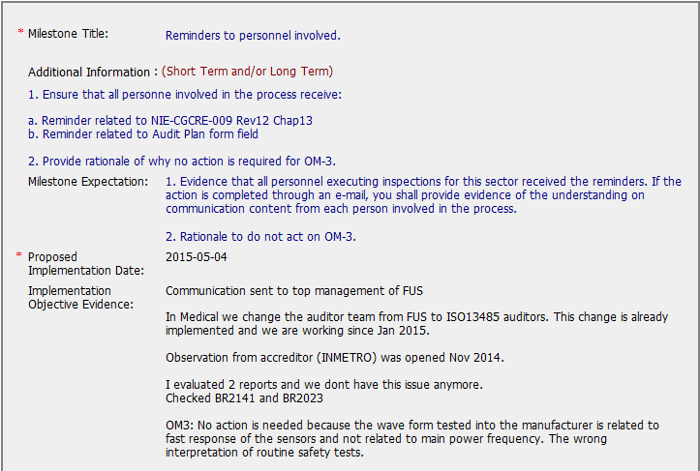
CAR 153914555
Very detailed info here which seems not necessary for OFI

Slide 6
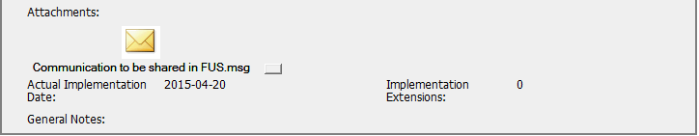
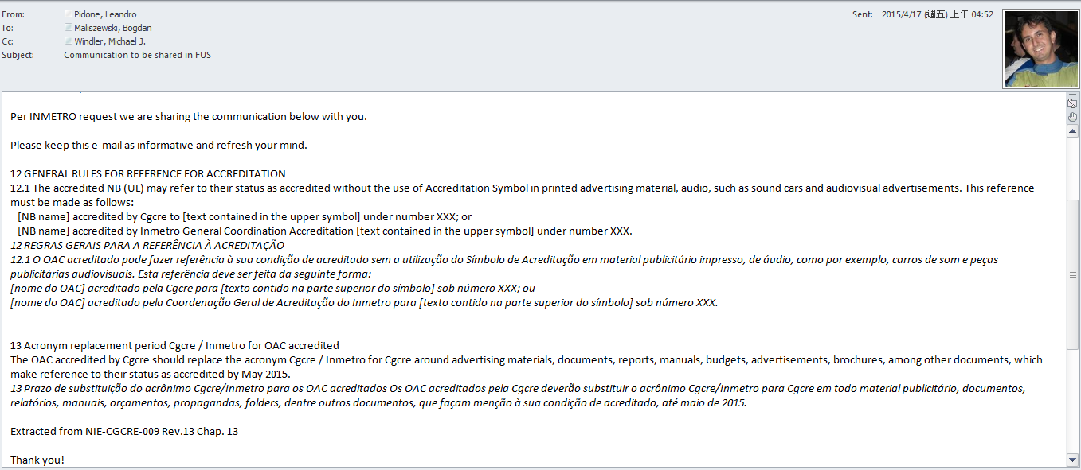
CAR 153914555 Milestone

Slide 7
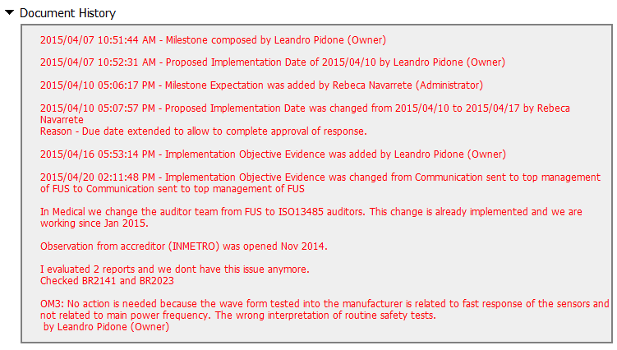
CAR 153914555 Milestone History
Verifications

Slide 8
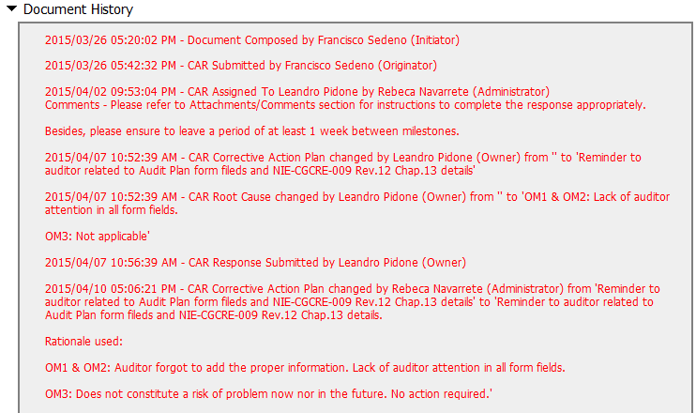
CAR 153914555

Slide 9
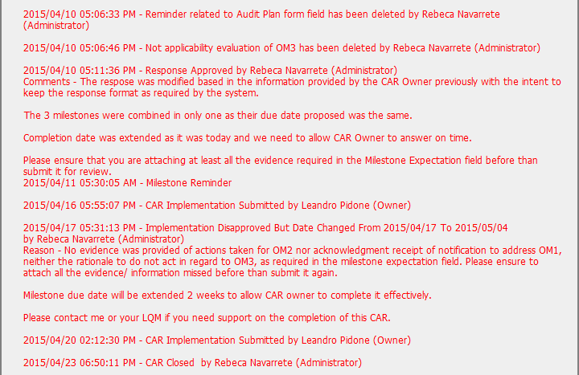
CAR 153914555
Very lengthy info for a simple OFI. Suggest exclude OFI in GCAR system to remove some headache from Operations. (Or separate OFI from Ob & establish a simple process for OFI.)

Slide 10
CAR 153914555 – CBS Check
CBS Requirements | Excellent | Moderate | Need Improve | N/A
(C) Extensions are within requirement (<30 days, 3 or less) |  | X
(T) Most appropriate ‘category’, ‘type’, ‘geography’ are selected |  | X
(P) Facilitates the handling of disputed CARs |  |  |  | X
(T) Acts on CARs within required timeframe |  | X
(C) Analysis shows clear path to root cause and scope; stakeholders identified |  |  |  | X
(C) Root cause statement is succinct, reasonable, complete (Shows ‘N/A’ for observations) |  | X
(C) Corrective actions fix the objective evidence and other problems found; address entire root cause and scope. For observations, they do not go beyond fixing the objective evidence |  | X
(C) Milestones address containment & owner’s verification; completed per milestone expectations |  | X
(P) Verification per requirements |  | X
(L) Referenced communications are attached as needed |  |  |  | X
(C L) Evidence of communication for overdue/escalated CARs and other pertinent concerns |  |  |  | X
(P) Trains other CAR Champions |  |  |  | X

